Slide 1
Query Processing Heuristic Query Optimization

Slide 2
σ _{marks >60} (π _{marks} (student_marks))
π _{marks} ( σ _{marks >60} (student_marks))

Slide 3
Processing a Query
Tasks in processing a high-level query
Scanner scans the query and identifies the language tokens
Parser checks syntax of the query
The query is validated by checking that all attribute names and relation names are valid
An intermediate internal representation for the query is created (query tree or query graph)
Query execution strategy is developed
Query optimizer produces an execution plan
Code generator generates the object code
Runtime database processor executes the code
Query processing and query optimization

Slide 4
Processing a Query
Typical steps in processing a high-level query
Query in a high-level query language like SQL
Scanning, parsing, and validation
Intermediate-form of query like query tree
Query optimizer
Execution plan
Query code generator
Object-code for the query
Run-time database processor
Results of query

Slide 5
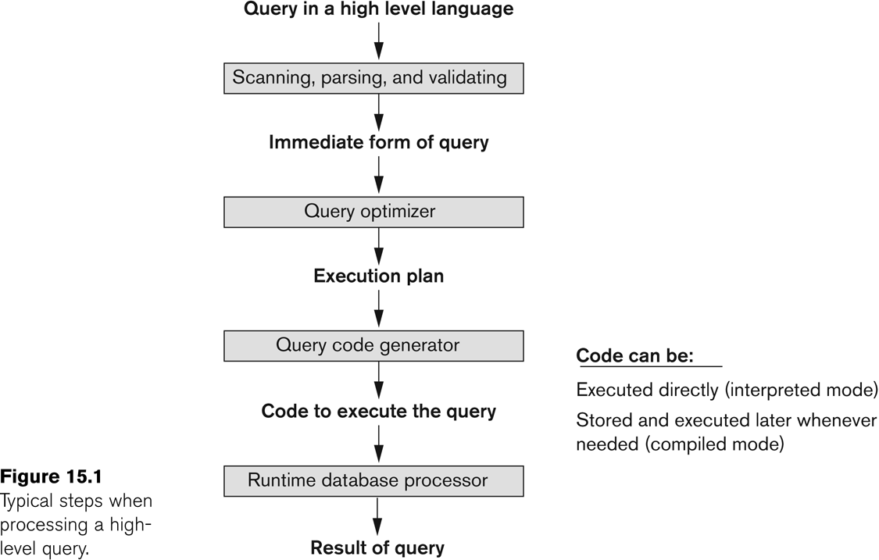
Processing a Query

Slide 6
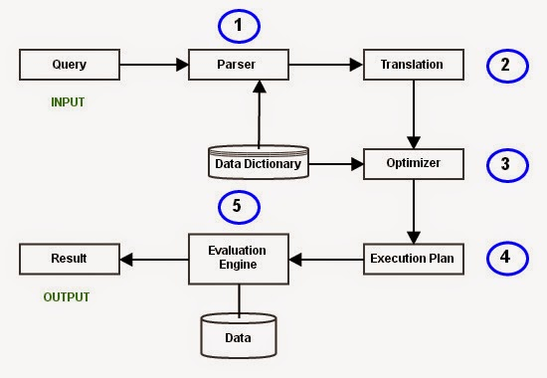

Slide 7
Input:
A query written in SQL is given as input to the query processor.
Parsing
In this step, the parser of the query processor module checks the syntax of the query, the user’s privileges to execute the query, the table names and attribute names, etc. The correct table names, attribute names and the privilege of the users can be taken from the system catalog (data dictionary).

Slide 8
Translation
If we have written a valid query, then it is converted from high level language SQL to low level instruction in Relational Algebra.
For example, our SQL query can be converted into a Relational Algebra equivalent as follows;
SELECT Ename FROM Employee, Proj_Assigned WHERE Employee.Eno = Proj_Assigned.Eno AND DOP > 10;
π_{Ename}(σDOP>10 Λ Employee.Eno=Proj_Assigned.Eno (Employee X Prof_Assigned))

Slide 9
Optimizer
Optimizer uses the statistical data stored as part of data dictionary. The statistical data are information about the size of the table, the length of records, the indexes created on the table, etc. Optimizer also checks for the conditions and conditional attributes which are parts of the query.

Slide 10
Execution Plan
A query can be expressed in many ways. The query processor module, at this stage, using the information collected in step 3 to find different relational algebra expressions that are equivalent and return the result of the one which we have written already.
For our example, the query written in Relational algebra can also be written as the one given below;
π_{Ename}(Employee ⋈_{Eno} (σ_{DOP>10} (Prof_Assigned)))
So far, we have got two execution plans. Only condition is that both plans should give the same result.

Slide 11
Evaluation
At this stage, we choose one execution plan of the several we have developed. This Execution plan accesses data from the database to give the final result.
In our example, the second plan may be good. In the first plan, we join two relations (costly operation) then apply the condition (conditions are considered as filters) on the joined relation. This consumes more time as well as space.
In the second plan, we filter one of the tables (Proj_Assigned) and the result is joined with the Employee table. This join may need to compare less number of records. Hence, the second plan is the best (with the information known, not always).

Slide 12
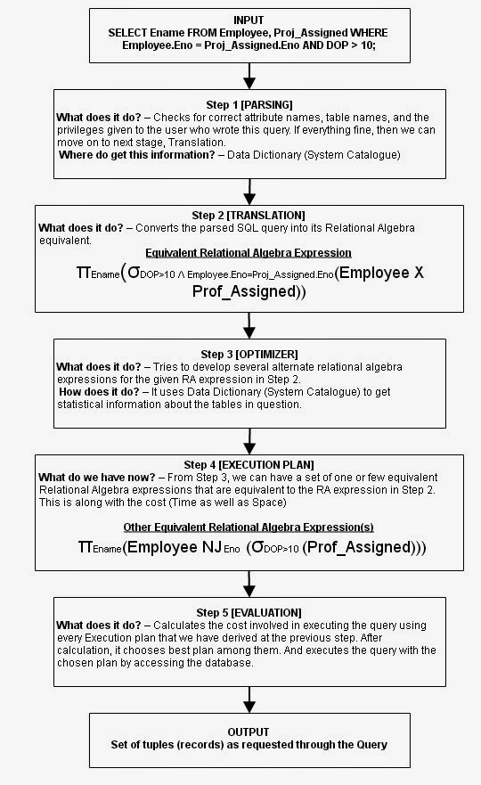

Slide 13
Heuristic Optimization of Query Trees
Heuristic: Rule that leads to the least cost in most cases
Query Tree (relational algebra expression)
leaf node :relations
Internal node :relational algebra operations
execution of query trees: post order traversal of tree

Slide 14
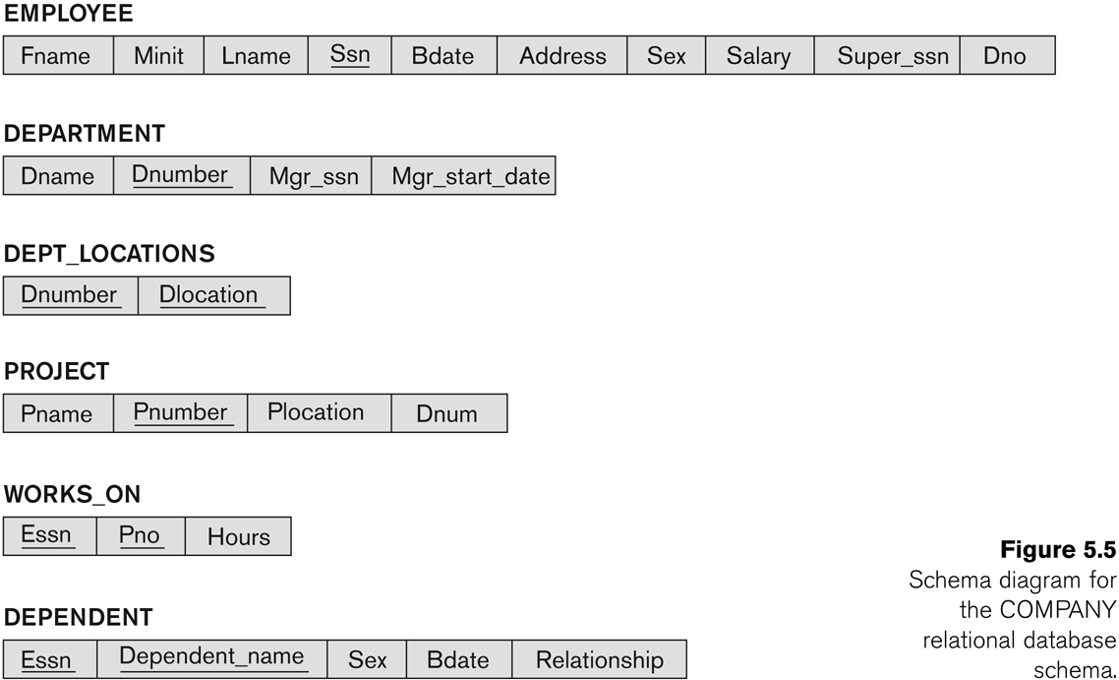
Heuristic Optimization of Query Trees-Example

Slide 15
Heuristic Optimization of Query Trees-Example
Query
"Find the last names of employees born after 1957 who work on a project named ‘Aquarius’."
SQL
SELECT LNAME
FROM EMPLOYEE, WORKS_ON, PROJECT
WHERE PNAME=‘Aquarius’ AND PNUMBER=PNO AND ESSN=SSN AND BDATE.‘1957-12-31’;

Slide 16
Steps in converting a query tree during heuristic optimization.
a) Initial (canonical) query tree for SQL query Q.
b) Moving SELECT operations down the query tree.
c) Applying the more restrictive SELECT operation first.
d) Replacing CARTESIAN PRODUCT and SELECT with JOIN operations.
e) Moving PROJECT operations down the query tree.

Slide 17
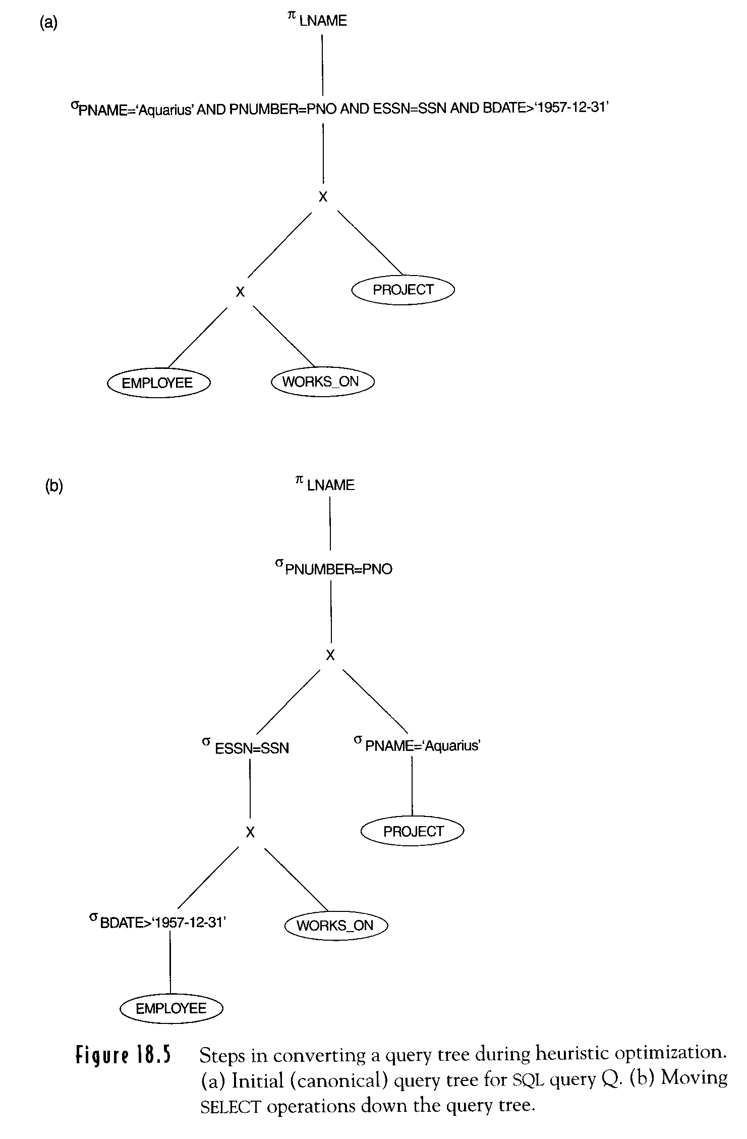
SELECT LNAME FROM EMPLOYEE, WORKS_ON, PROJECT WHERE PNAME=“Aquarius’ AND PNUMBER=PNO AND ESSN=SSN AND BDATE > ‘DEC-31-1957’
Canonical query tree

Slide 18
a) Executing this tree directly first creates a very large file containing the CARTESIAN PRODUCT of the entire EMPLOYEE, WORKS_ON, and PROJECT files. That is why the initial query tree is never executed, but is transformed into another equivalent tree that is efficient to execute. This particular query needs only one record from the PROJECT relation— for the ‘Aquarius’ project—and only the EMPLOYEE records for those whose date of birth is after ‘1957-12-31’.

Slide 19
Moving SELECT operations down the query tree

Slide 20
(b) shows an improved query tree that first applies the SELECT operations to reduce the number of tuples that appear in the CARTESIAN PRODUCT.

Slide 21
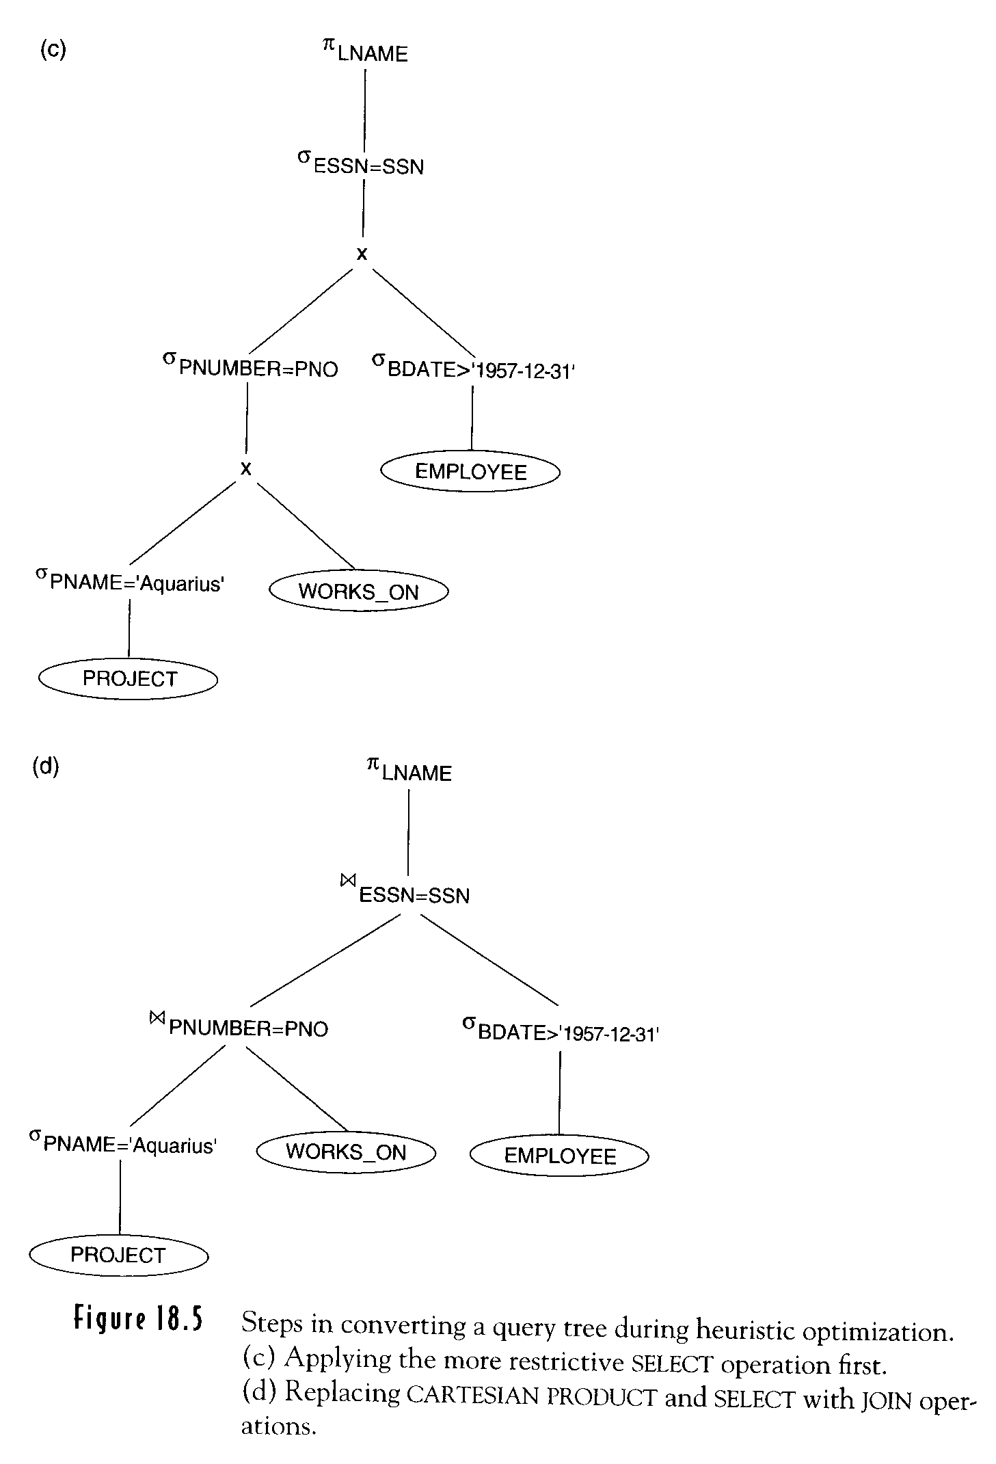
(c) Applying more restrictive SELECT operation first
SELECT LNAME FROM EMPOYEE, WORKS_ON, PROJECT WHERE PNAME=‘Aquarius’ AND PUMBER=PNO AND ESSN=SSN AND BDATE > ‘DEC-31-1957’

Slide 22
c) A further improvement is achieved by switching the positions of the EMPLOYEE and PROJECT relations in the tree, as shown in Figure (c). This uses the information that Pnumber is a key attribute of the PROJECT relation, and hence the SELECT operation on the PROJECT relation will retrieve a single record only.

Slide 23
Replacing CARTESIAN PRODUCT and SELECT with JOIN

Slide 24
d) We can further improve the query tree by replacing any CARTESIAN PRODUCT operation that is followed by a join condition with a JOIN operation, as shown in Figure(d).

Slide 25
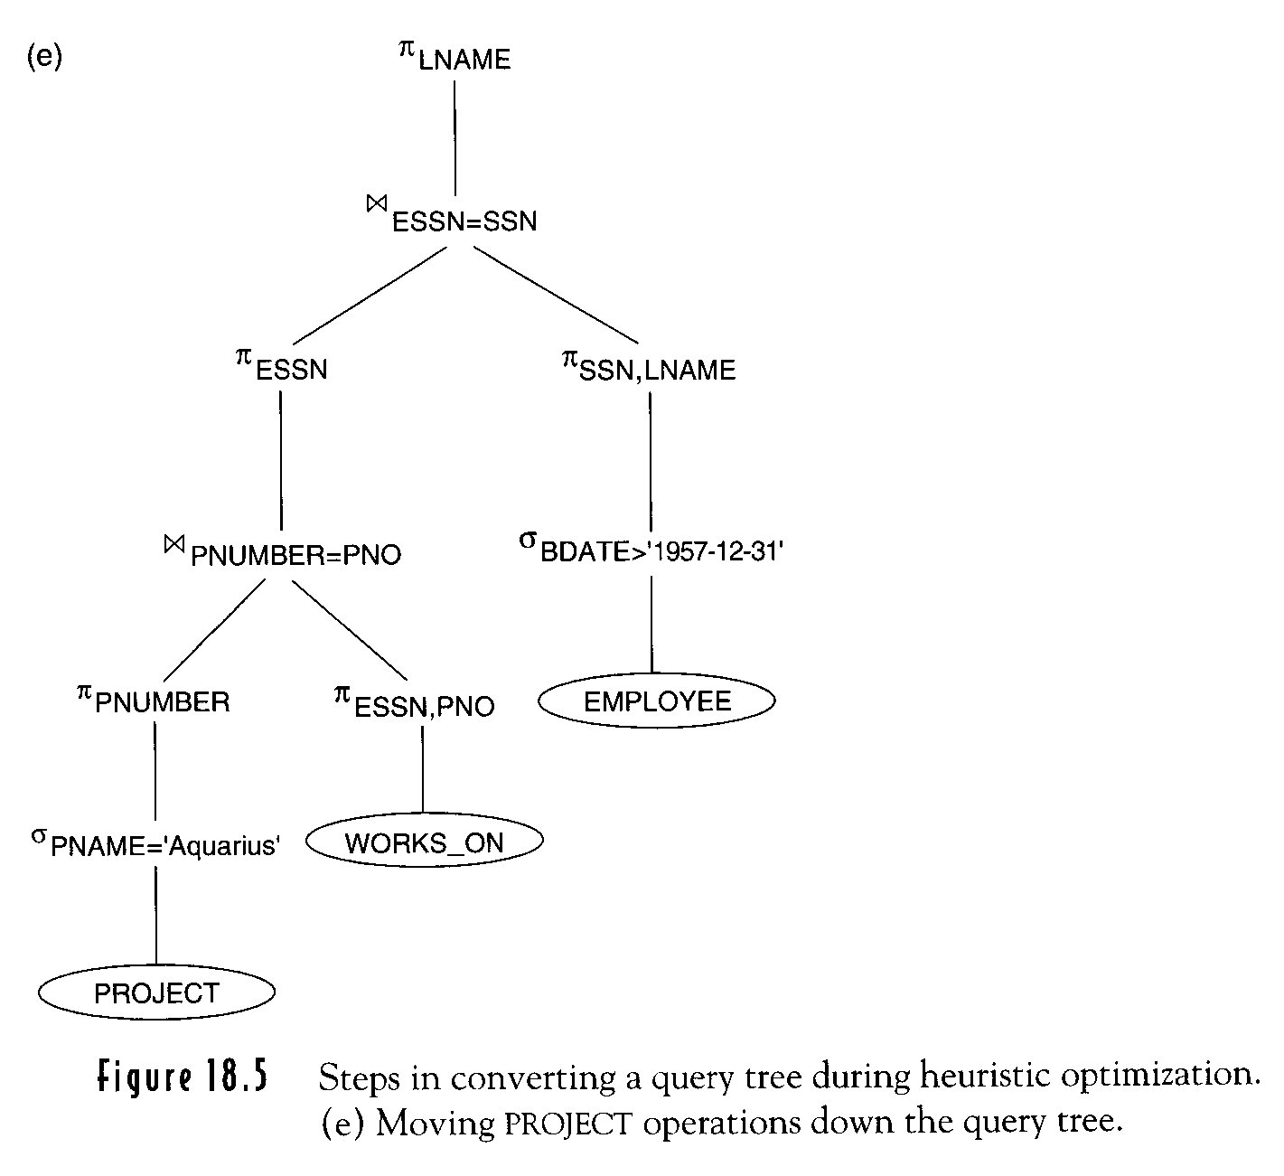
Moving PROJECT operations down
Transformation should keep equivalence

Slide 26
e) Another improvement is to keep only the attributes needed by subsequent operations in the intermediate relations, by including PROJECT (π) operations as early as possible in the query tree, as shown in Figure (e). This reduces the attributes (columns) of the intermediate relations, whereas the SELECT operations reduce the number of tuples (records).

Slide 27
SQL Query with an Uncorrelated Subquery
Find the movies with stars born in 1960
MovieStar(name, address, gender, birthdate)
StarsIn(title, year, starName)
SELECT title
FROM StarsIn
WHERE starName IN (
SELECT name
FROM MovieStar
WHERE birthdate LIKE ‘%1960’
);

Slide 28
Parse Tree
<Query>
<SFW>
SELECT <SelList> FROM <FromList> WHERE <Condition>
<Attribute> <RelName> <Tuple> IN <Query>
title StarsIn <Attribute> ( <Query> )
starName <SFW>
SELECT <SelList> FROM <FromList> WHERE <Condition>
<Attribute> <RelName> <Attribute> LIKE <Pattern>
name MovieStar birthDate ‘%1960’

Slide 29
Generating Relational Algebra
Πtitle
Two-argument selection
σ
StarsIn <condition>
<tuple> IN Πname
<attribute> σbirthdate LIKE ‘%1960’
starName MovieStar

Slide 30
Applying the Rewrite Rule
Πtitle
Πtitle
σstarName=name
σ
×
StarsIn <condition>
<tuple> IN Πname
StarsIn δ
Πname
<attribute> σ_{birthdate LIKE ‘%1960’}
σbirthdate LIKE ‘%1960’
starName MovieStar
MovieStar

Slide 31
Improving the Logical Query Plan
Πtitle
Πtitle
σstarName=name
×
starName=name
StarsIn δ
StarsIn Πname
Πname
σbirthdate LIKE ‘%1960’
σbirthdate LIKE ‘%1960’
MovieStar
MovieStar

Slide 32
SQL Queries and Relational Algebra (1)
Example
SELECT Lname, Fname
FROM EMPLOYEE
WHERE Salary > ( SELECT MAX(Salary)
FROM EMPLOYEE
WHERE Dno = 5 )
Inner block and outer block

Slide 33
Translating SQL Queries into Relational Algebra
SELECT LNAME, FNAME
FROM EMPLOYEE
WHERE > ( SELECT MAX (SALARY)
SALARY FROM EMPLOYEE
WHERE DNO = 5);
SELECT LNAME, FNAME
FROM EMPLOYEE
WHERE SALARY > C
SELECT MAX (SALARY)
FROM EMPLOYEE
WHERE DNO = 5
π_{LNAME, FNAME} (σ_{SALARY>C}(EMPLOYEE))
ℱ_{MAX SALARY} (σ_{DNO=5} (EMPLOYEE))

Slide 34
SQL Queries and Relational Algebra (2)
Uncorrelated nested queries Vs Correlated nested queries
Example
Retrieve the name of each employee who works on all the projects controlled by department number 5.
SELECT FNAME, LNAME FROM EMPLOYEE WHERE ( (SELECT PNO FROM WORKS_ON WHERE SSN=ESSN) CONTAINS (SELECT PNUMBER FROM PROJECT WHERE DNUM=5) )

Slide 35
SQL Queries and Relational Algebra (3)
Example
For every project located in ‘Stafford’, retrieve the project number, the controlling department number and the department manager’s last name, address and birthdate.
SQL query:
SELECT P.NUMBER,P.DNUM,E.LNAME, E.ADDRESS, E.BDATE
FROM PROJECT AS P,DEPARTMENT AS D, EMPLOYEE AS E
WHERE P.DNUM=D.DNUMBER AND D.MGRSSN=E.SSN AND P.PLOCATION=‘STAFFORD’;
Relation algebra:
πPNUMBER, DNUM, LNAME, ADDRESS, BDATE (((σ_{PLOCATION=‘STAFFORD’}(PROJECT)) _{DNUM=DNUMBER} (DEPARTMENT)) _{MGRSSN=SSN} (EMPLOYEE))

Slide 36
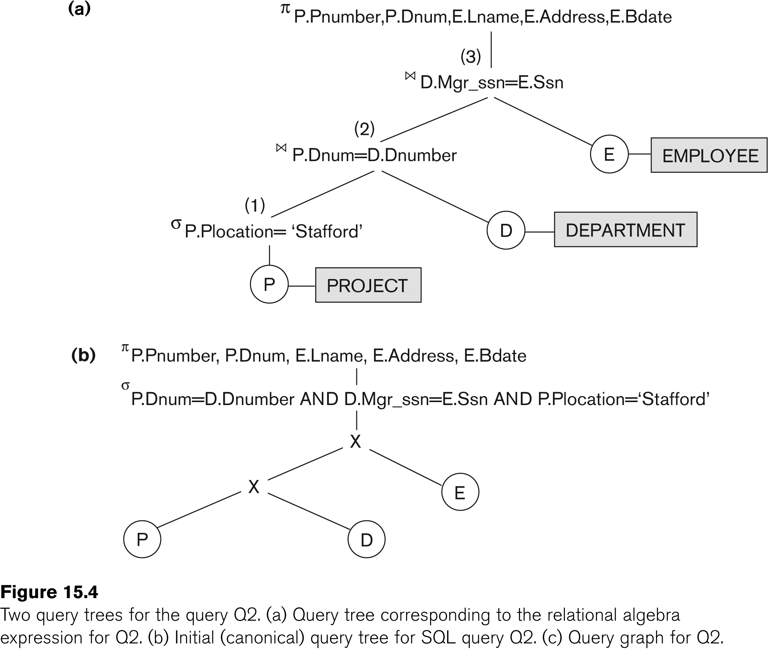
SQL Queries and Relational Algebra (4)

